Slide 1
Chapter 4: Understanding Quality Attributes
Pingjian Zhang
School of Software Engineering, SCUT
2018

Slide 2
Chapter Outline
Architecture and Requirements
Functionality
Quality Attribute Considerations
Specifying Quality Attribute Requirements
Achieving Quality Attributes through Tactics
Guiding Quality Design Decisions
Summary

Slide 3
Architecture and Requirements
System requirements can be categorized as:
Functional requirements. What & How
Quality attribute requirements. How well.
Constraints. A constraint is a design decision already been made.
Notes:
比如说，规定要使用现有组件、通信协议

Slide 4
Functionality
Functionality is the ability of the system to do the work for which it was intended.
Functionality has a strange relationship to architecture:
functionality does not determine architecture; given a set of required functionality, there is no end to the architectures you could create to satisfy that functionality
Notes:
正交关系：坐标系

Slide 5
Quality Attribute Considerations
If a functional requirement is "when the user presses the green button the Options dialog appears”:
a performance QA annotation might describe how quickly the dialog will appear;
an availability QA annotation might describe how often this function will fail, and how quickly it will be repaired;
a usability QA annotation might describe how easy it is to learn this function.

Slide 6
Specifying Quality Attribute Requirements
Quality attribute scenarios has these parts:
Stimulus
Stimulus source
Response
Response measure
Environment
Artifact

Slide 7
Specifying Quality Attribute Requirements
Source of stimulus. This is some entity (a human, a computer system, or any other actuator) that generated the stimulus.
Stimulus. The stimulus is a condition that requires a response when it arrives at a system.
Environment. The stimulus occurs under certain conditions.
Artifact. Some artifact is stimulated.
Response. The response is the activity undertaken on the arrival of the stimulus.
Response measure. When the response occurs, it should be measurable in some fashion so that the requirement can be tested.

Slide 8
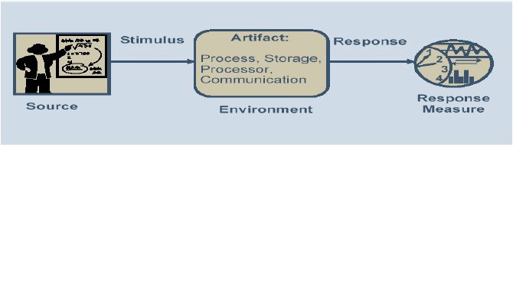
Quality Attribute Scenario
Internal / external
Whole system / parts of system
Notes:
6 parts

Slide 9
Specifying Quality Attribute Requirements
General scenarios—those that are system independent and can, potentially, pertain to any system.
Concrete scenarios—those that are specific to the particular system under consideration.

Slide 10
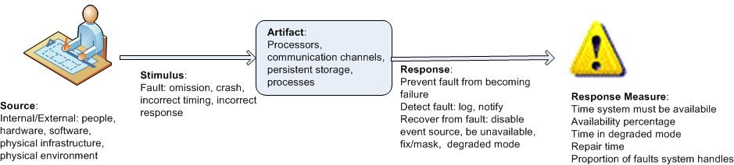
Specifying Quality Attribute Requirements
Example general scenario for availability:
Notes:
Concrete scenario for availability

Slide 11
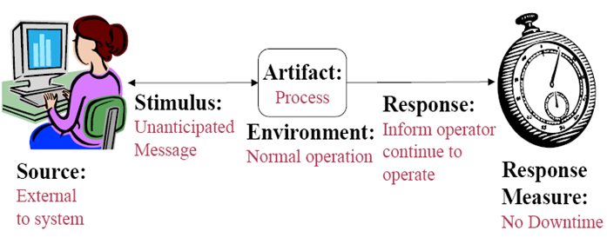
Specifying Quality Attribute Requirements
Example concrete scenario for availability

Slide 12
Achieving Quality Attributes Through Tactics
There are a collection of primitive design techniques that an architect can use to achieve a quality attribute response.
We call these architectural design primitives tactics.
Tactics, like design patterns, are techniques that architects have been using for years. We do not invent tactics, we simply capture what architects do in practice.

Slide 13
Achieving Quality Attributes Through Tactics
Why do we do this? There are three reasons:
Design patterns are complex; they are a bundle of design decisions. An architect can augment an existing pattern to achieve a quality attribute goal.
If no pattern exists to realize the architect’s design goal, tactics allow the architect to construct a design fragment from “first principles”.
By cataloguing tactics, we make design more systematic.

Slide 14
Guiding Quality Design Decisions
Architecture design is a systematic approach to making design decisions.
We categorize the design decisions that an architect needs to make as follows:
Allocation of responsibilities
Coordination model
Data model
Management of resources
Mapping among architectural elements
Binding time decisions
Choice of technology

Slide 15
Allocation of Responsibilities
Decisions involving allocation of responsibilities include:
identifying the important responsibilities including basic system functions, architectural infrastructure, and satisfaction of quality attributes.
determining how these responsibilities are allocated to non-runtime and runtime elements (namely, modules, components, and connectors).

Slide 16
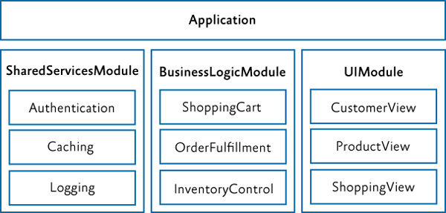

Slide 17
Coordination Model
Decisions about the coordination model include:
identify the elements of the system that must coordinate, or are prohibited from coordinating
determining the properties of the coordination, such as timeliness, currency, completeness, correctness, and consistency
choosing the communication mechanisms that realize those properties.
Notes:
Important properties of the communication mechanisms include stateful vs. stateless, synchronous vs. asynchronous, guaranteed vs. non-guaranteed delivery, and performance-related properties such as throughput and latency
TCP/UDP, WS/Restful

Slide 18


Slide 19
Data Model
Decisions about the data model include:
choosing the major data abstractions, their operations, and their properties.
metadata needed for consistent interpretation of the data
organization of the data. This includes determining whether the data is going to be kept in a relational data base, a collection of objects or both

Slide 20
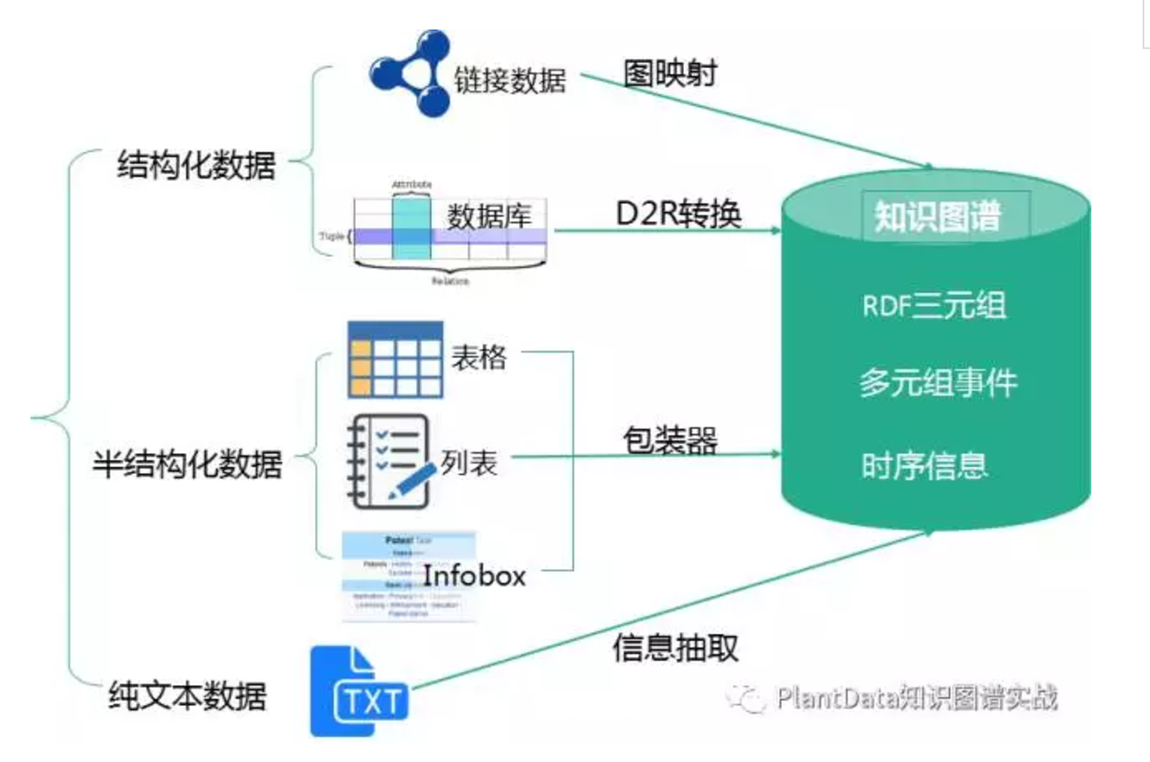

Slide 21
Management of Resources
Decisions for management of resources include:
identifying the resources that must be managed and determining the limits for each
determining which system element(s) manage each resource
determining how resources are shared and the arbitration strategies employed when there is contention
determining the impact of saturation on different resources.

Slide 22
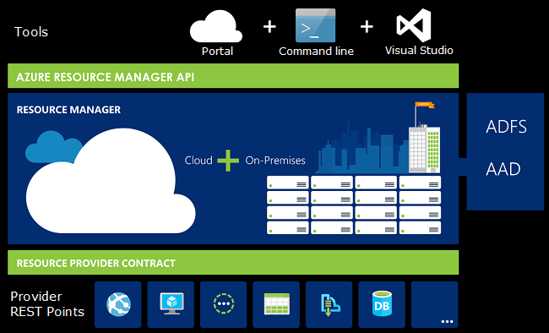

Slide 23
Mapping Among Architectural Elements
Useful mappings include:
the mapping of modules and runtime elements to each other—that is, the runtime elements that are created from each module; the modules that contain the code for each runtime element
the assignment of runtime elements to processors
the assignment of items in the data model to data stores
the mapping of modules and runtime elements to units of delivery

Slide 24
Binding Time
The decisions in the other categories have an associated binding time decision. Examples of such binding time decisions include:
For allocation of responsibilities you can have build-time selection of modules via a parameterized build script.
For choice of coordination model you can design run-time negotiation of protocols.
For resource management you can design a system to accept new peripheral devices plugged in at run-time.
For choice of technology you can build an app-store for a smart phone that automatically downloads the appropriate version of the app.
Notes:
Build.xml, makefile都支持自定义变量
ftp协议：主动模式还是被动模式，字符方式还是字节方式

Slide 25
Choice of Technology
Choice of technology decisions involve:
deciding which technologies are available to realize the decisions made in the other categories
determining whether the tools to support this technology are adequate
determining the extent of internal familiarity and external support for the technology (such as courses, tutorials, examples, availability of contractors)
determining the side effect
determining whether a new technology is compatible with the existing technology stack

Slide 26
Summary
Requirements for a system come in three categories.
Functional.
Quality attribute.
Constraints.
Quality attribute scenario has 6 parts.
Source of stimulus.
Stimulus
Environment.
Artifact.
Response.
Response measure.

Slide 27
Summary
An architectural tactic is a design decision that affects a quality attribute response.
Architectural patterns can be seen as “packages” of tactics.
The seven categories of architectural design decisions are:
Allocation of responsibilities
Coordination model
Data model
Management of resources
Mapping among architectural elements
Binding time decisions
Choice of technology

